Slide 1

Optical Character Recognition
Forrest Bankston

Slide 2
Outline
Introduction/What is the Purpose?
My Work
OCR Image Pre-processing
Demonstration

Slide 3
Introduction
OCR – Optical Character Recognition
Electronic/Mechanical conversion of images into machine-encoded text which can then be outputted in a readable format
Images - a scanned document, a photo of a document, a pdf etc.

Slide 4
What is the Purpose?
People often take pictures/scan important documents/receipts but this is just a picture
Without extra software, must type out the text to manipulate it, which can be very time-consuming
“Manipulate text” – Copy/paste, ctrl+f search to find a specific value/phrase
OCR can be applied to solve this problem and even if not 100% accurate can highlight key search phrases in a group of images

Slide 5
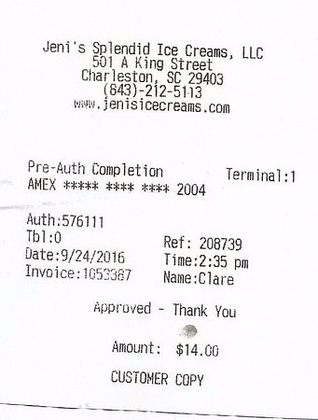
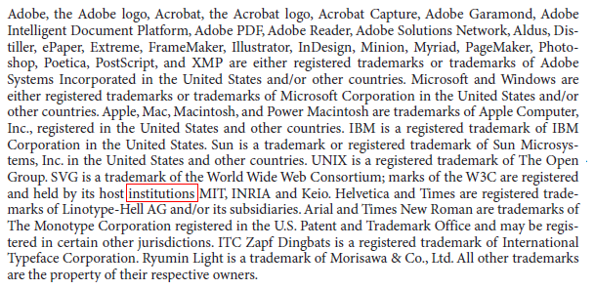
What is the Purpose?
Notes:
For an example, a student or professor doesn’t want to read 5 chapters of a scanned textbook to find one specific section for homework or notes
A business-owner/consumer that scans their receipts probably doesn’t want to log important details from these receipts by hand such as the payment method or time and date or ID number or number of things, and just scanning and not using OCR is not using a computer to its full potential. And there’s plenty of other real-life applications of OCR such as for logging medical forms, banks logging their checks, and stuff like that. And I’m gonna be using receipts for several of these examples because that is just a really common application and also my demonstration is going to include a test on a database of receipts. So,

Slide 6
My Work
Customizable OCR application with python
pytesseract for OCR(optional digit only extraction instead of all text)
Combination of OpenCV and python logic for pre-processing
Write contents of image to a text file after text extraction
Optional Batch convert folder and append all to text file
Tkinter GUI
Notes:
TK inter

Slide 7
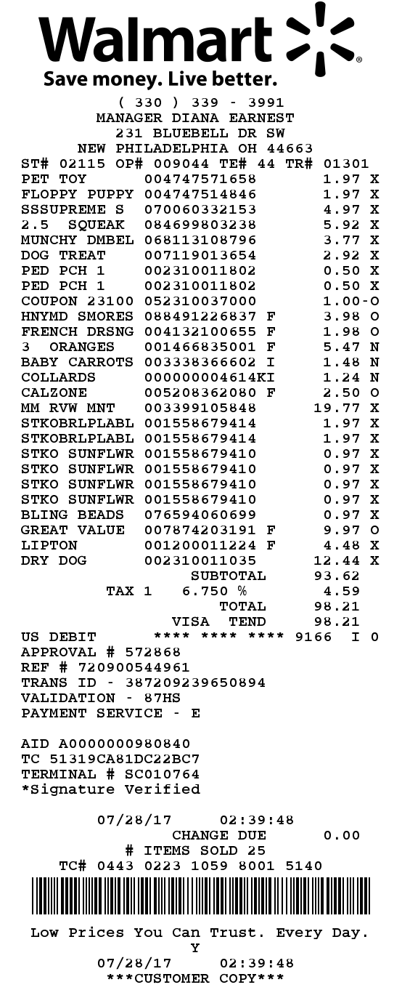
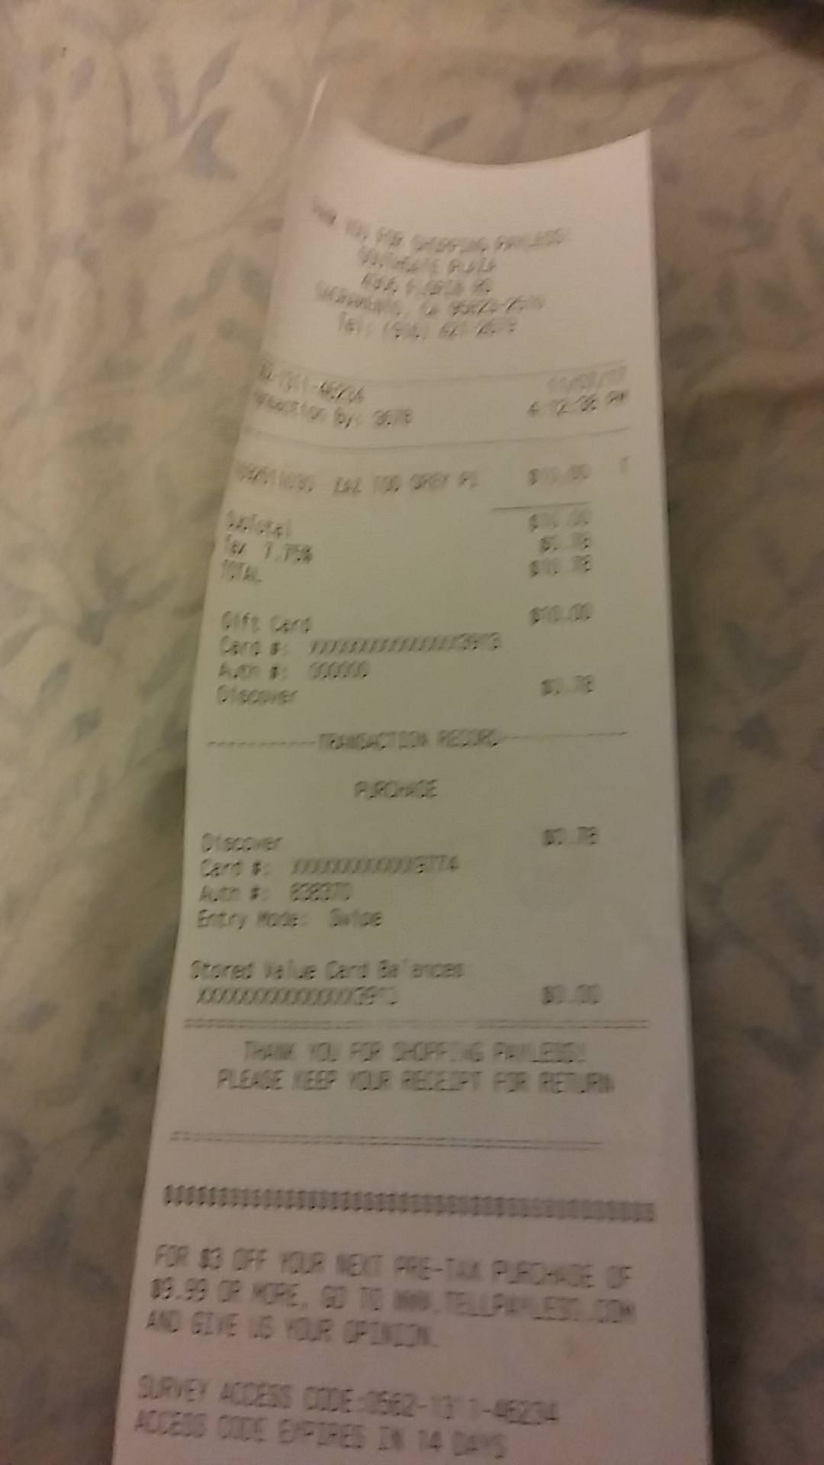
OCR Pre-Processing
Easier to perform OCR (Structured Text)
Harder to perform OCR (Unstructured Text)
Notes:
Going to talk about OCR pre-processing some because it’s very important and also not quite the same as preprocessing in other computer vision fields and also the demonstration doesn’t show the different phases of pre-processing being used so we can take a quick look at it now.
Scanned images are typically much easier to perform OCR on, but will still usually have some kind of noise that needs to be cleaned up. Images directly from a camera are typically much harder to perform OCR on and require more pre-processing to get any success at all. You can see this image on the left that is scanned well, and a good image like this is said to have structured text. And then the image on the right is not scanned at all it’s just a picture and it’s quite a poor picture, so something like this is going to be known as unstructured text and will be much harder to deal with.

Slide 8
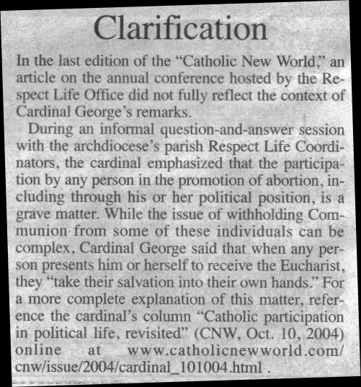
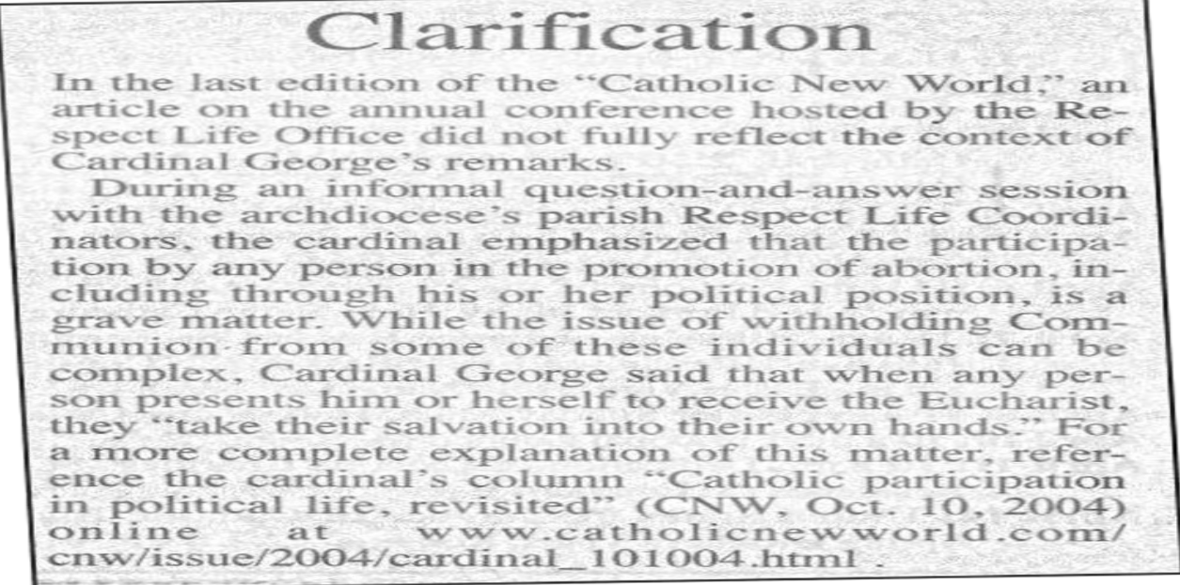
OCR Pre-Processing
Resize image to make it larger
Convert background to gray
Increase White region by dilating
Erode some boundaries of any foreground object
Notes:
To show an example of pre-processing, this first image here on the left looks like it might not be too bad, however there’s a lot of noise in the form of little shadows and that’s going to cause lots of problems when trying to recognize and extract text. So we start by resizing the image to make it bigger, we convert the background to gray, and then we are also gonna dilate the image to increase white region as well as erode away some of the boundaries of the foreground object. Second image is the result of all of that which is not quite ready for OCR but very good progress so far

Slide 9
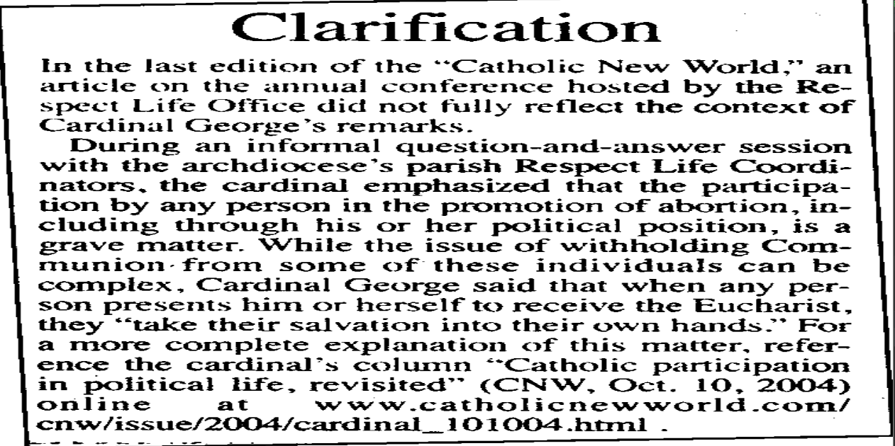
OCR Pre-Processing
Apply threshold to grayscale image to convert to black and white
Using Otsu’s thresholding in this case
Finished image is much better and suited for OCR
Notes:
Next we are going to apply a binary threshold to convert the grayscale image to black and white and make this text stand out a lot from the background. In my work I’m using Otsu thresholding because I found it to be the most effective binarization method for me. And after only a few steps we have resized the image and increased the size of the subject of interest, which is the text, and we have also removed a lot of the noise which could prevent a successful text recognition

Slide 10
Demonstration

